Slide 1
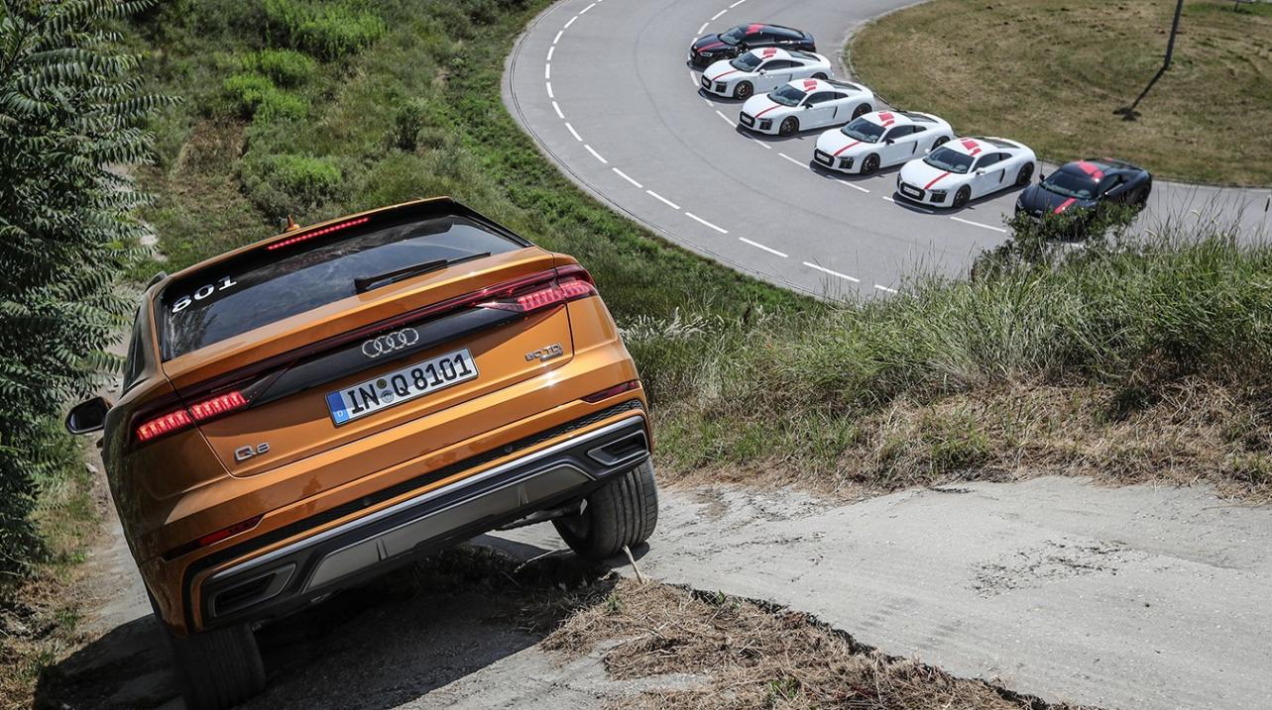
Audi
World Dealer Conference
Four week event
One week build up in the halls
300 guests per day / 100 cars
Driving action in On- & Off-Road
Hot laps with LMS pilots

Slide 2
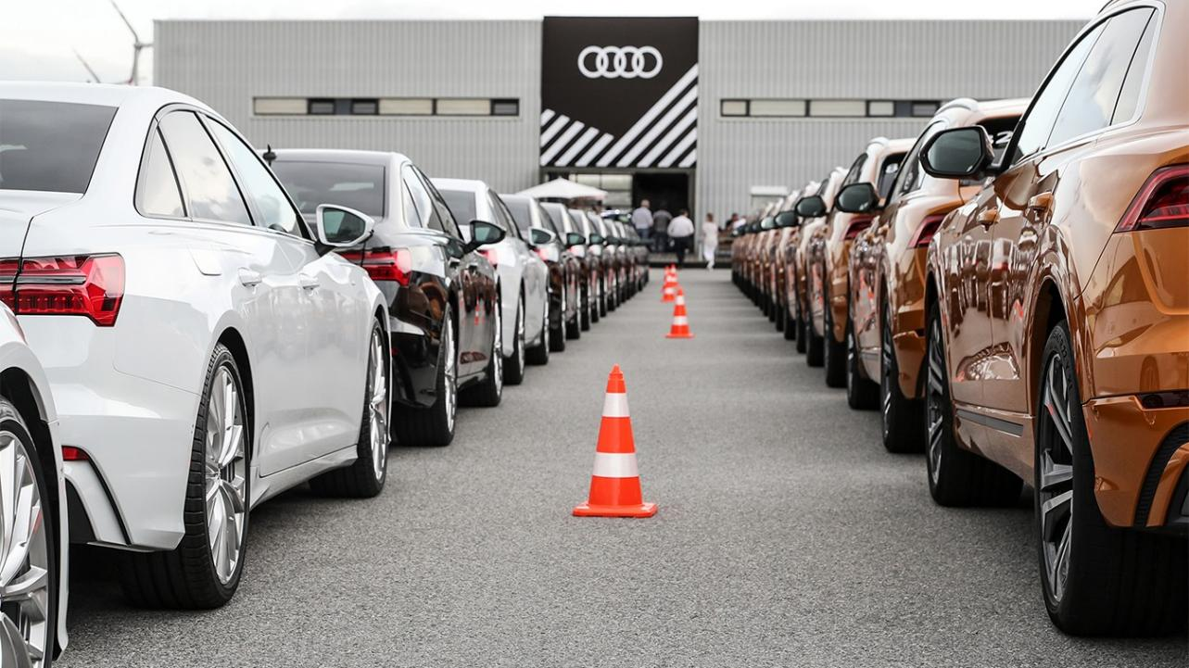
Audi
World Dealer Conference
Four week event
One week build up in the halls
300 guests per day / 100 cars
Driving action in On- & Off-Road
Hot laps with LMS pilots

Slide 3
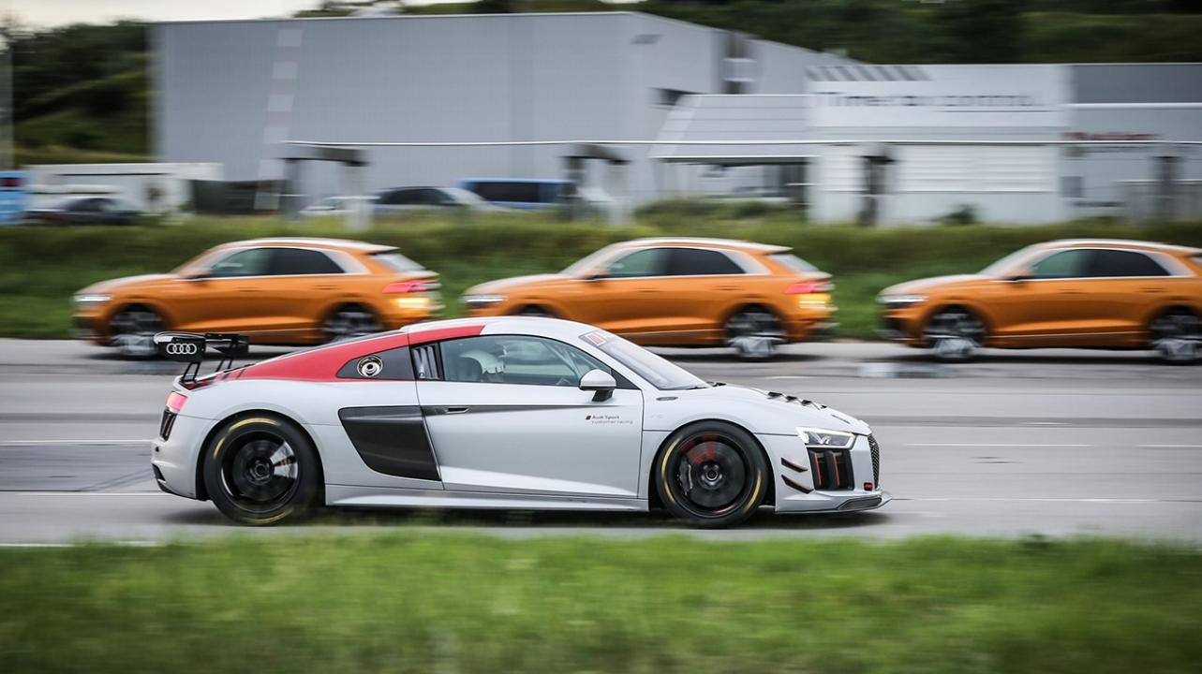
Audi
World Dealer Conference
Four week event
One week build up in the halls
300 guests per day / 100 cars
Driving action in On- & Off-Road
Hot laps with LMS pilots

Slide 4
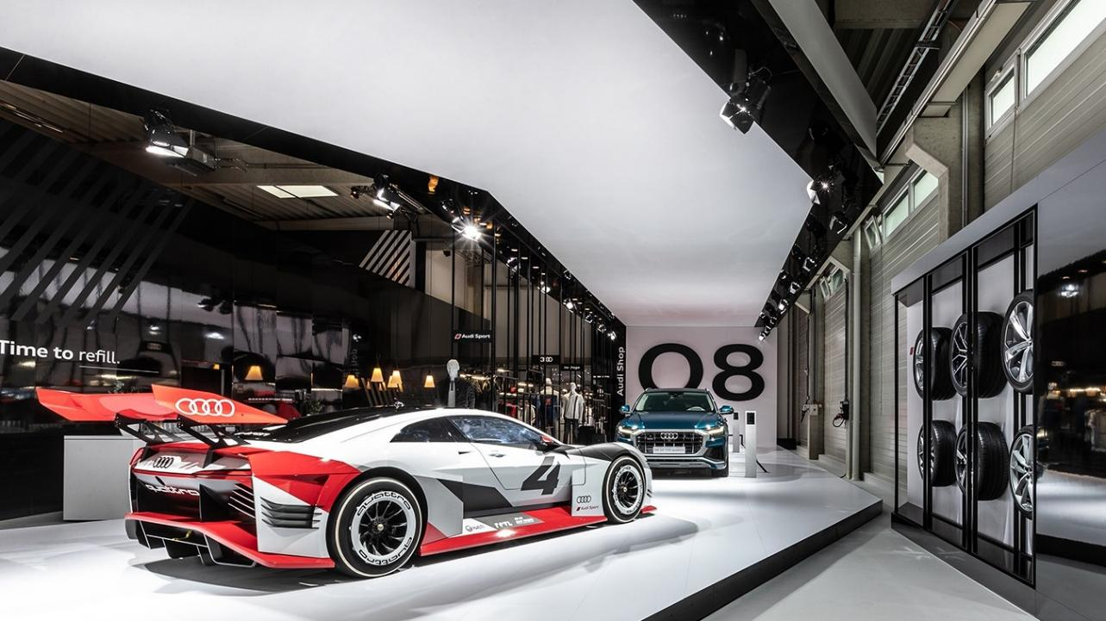
Audi
World Dealer Conference
Four week event
One week build up in the halls
300 guests per day / 100 cars
Driving action in On- & Off-Road
Hot laps with LMS pilots

Slide 5
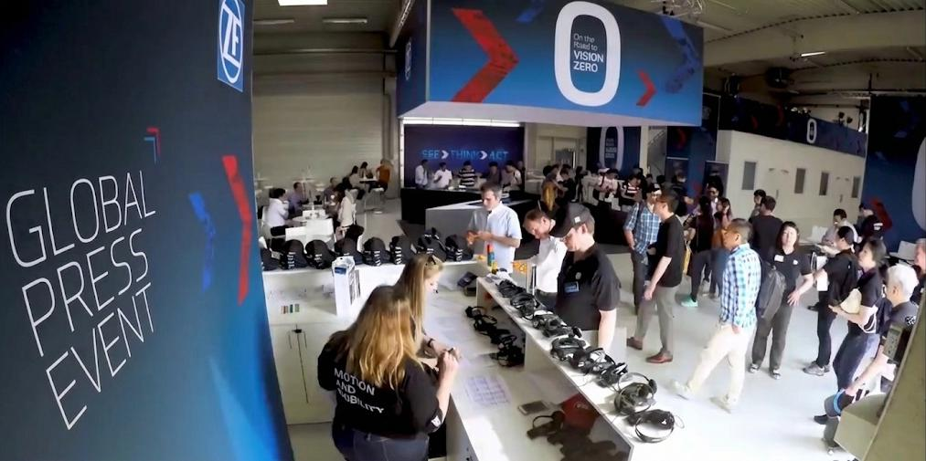
ZF Vision Zero
Global Tech Press Event
One week tech event
International press & media
Explanation of technical details
Demonstration of prototypes
Meeting of board members

Slide 6
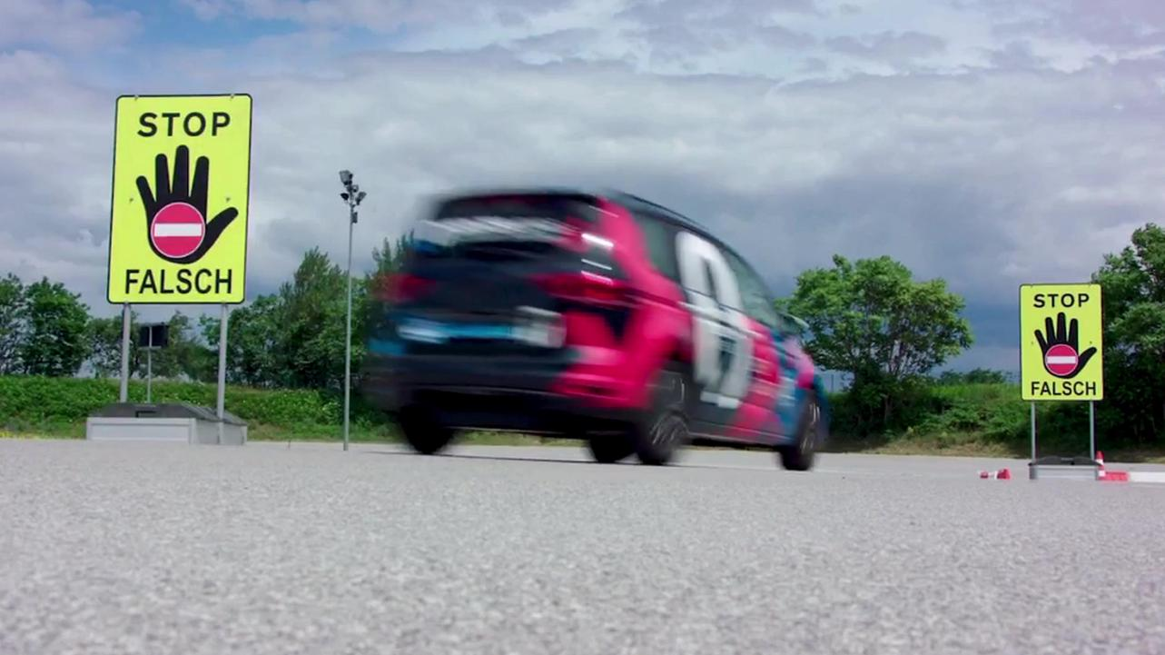
ZF Vision Zero
Global Tech Press Event
One week tech event
International press & media
Explanation of technical details
Demonstration of prototypes
Meeting of board members

Slide 7
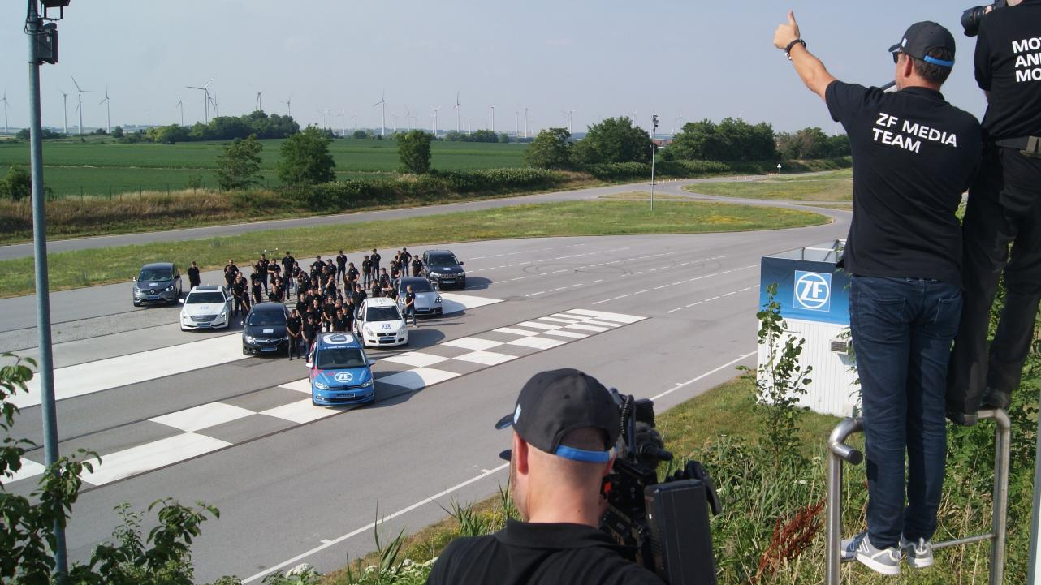
ZF Vision Zero
Global Tech Press Event
One week tech event
International press & media
Explanation of technical details
Demonstration of prototypes
Meeting of board members

Slide 8
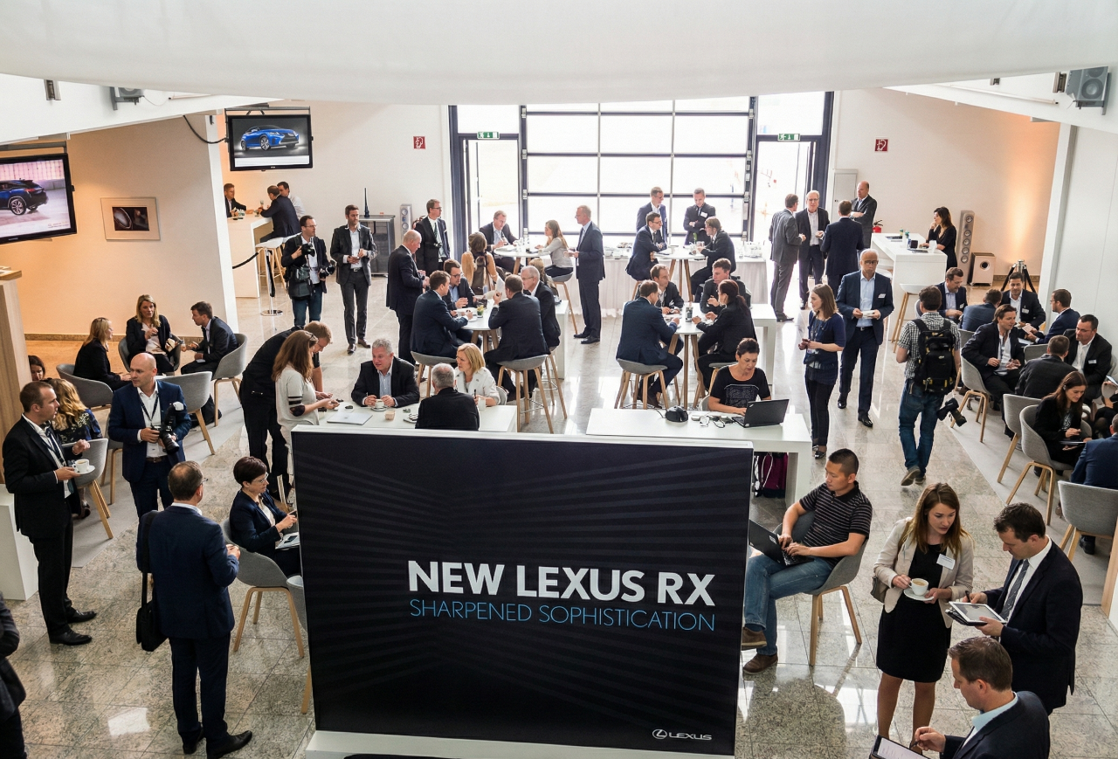
Lexus RX
International Dealer Event
Five event weeks
200 guests per day
Reveal in tv studio quality
Static & dynamic presentation
In- & Outdoor branding
*This picture was enhanced with AI.
*

Slide 9
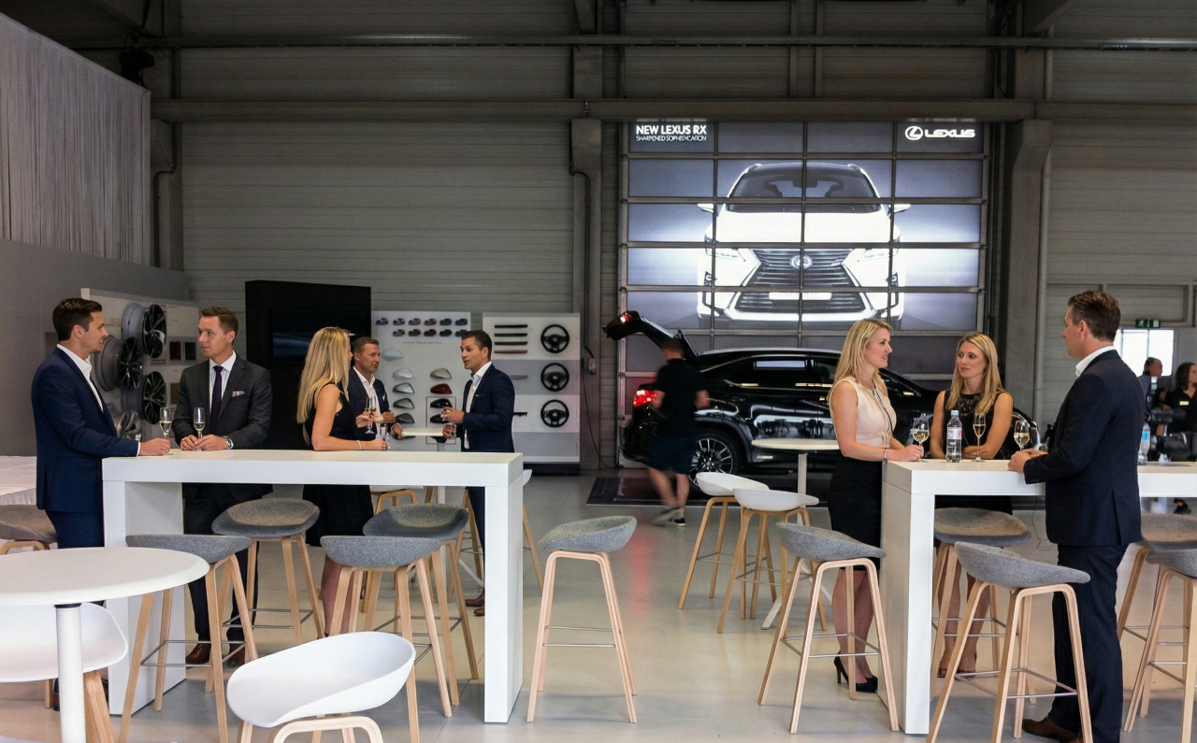
Lexus RX
International Dealer Event
Five event weeks
200 guests per day
Reveal in tv studio quality
Static & dynamic presentation
In- & Outdoor branding
*This picture was enhanced with AI.

Slide 10
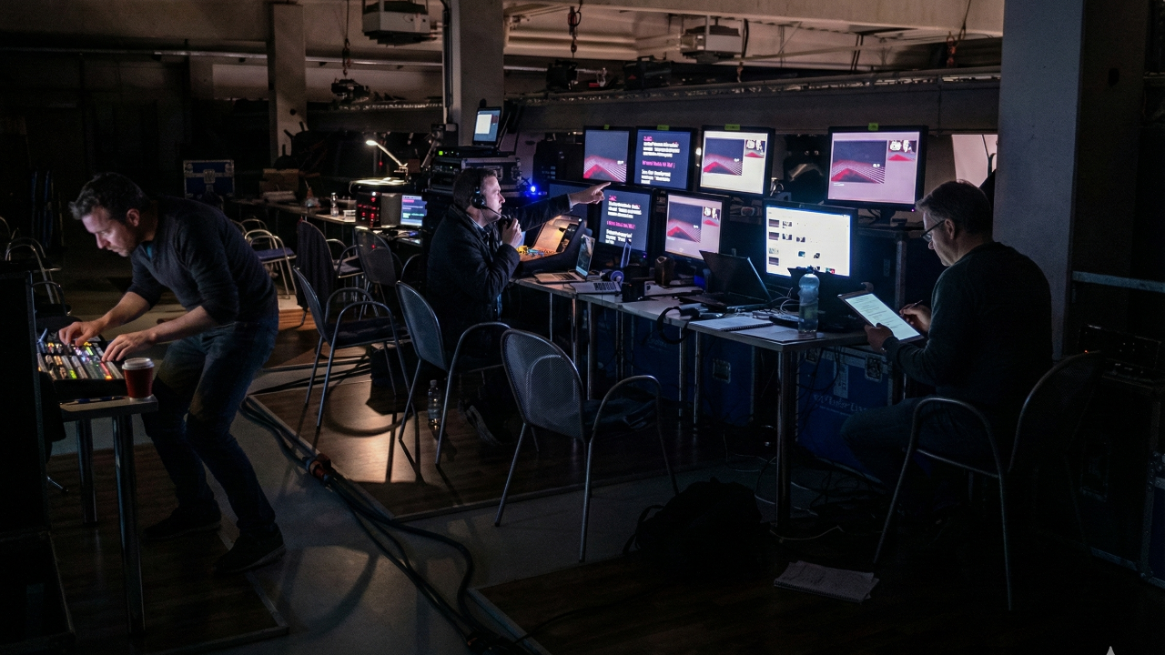
Lexus RX
International Dealer Event
Five event weeks
200 guests per day
Reveal in tv studio quality
Static & dynamic presentation
In- & Outdoor branding
*This picture was enhanced with AI.

Slide 11
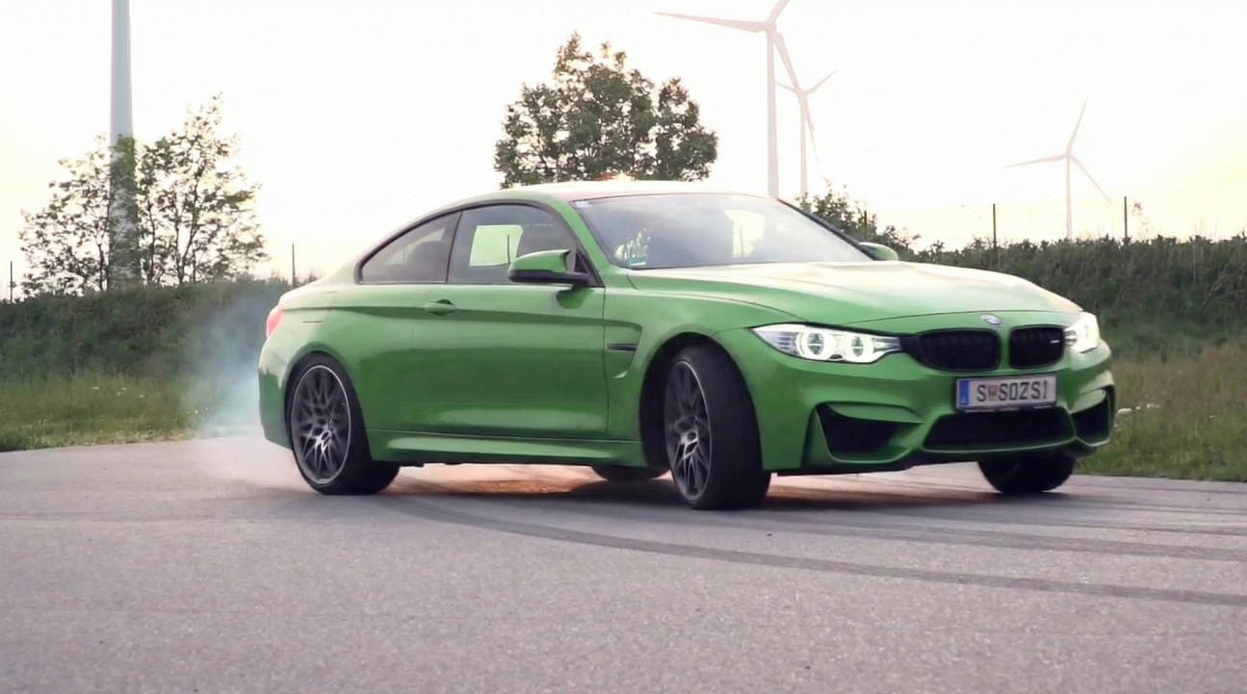
BMW M
Performance Tour
Authorised dealer event
For whole DACH-region
Testdrive of different models
Fast laps on (wet-)circuit
Presentation of latest features

Slide 12
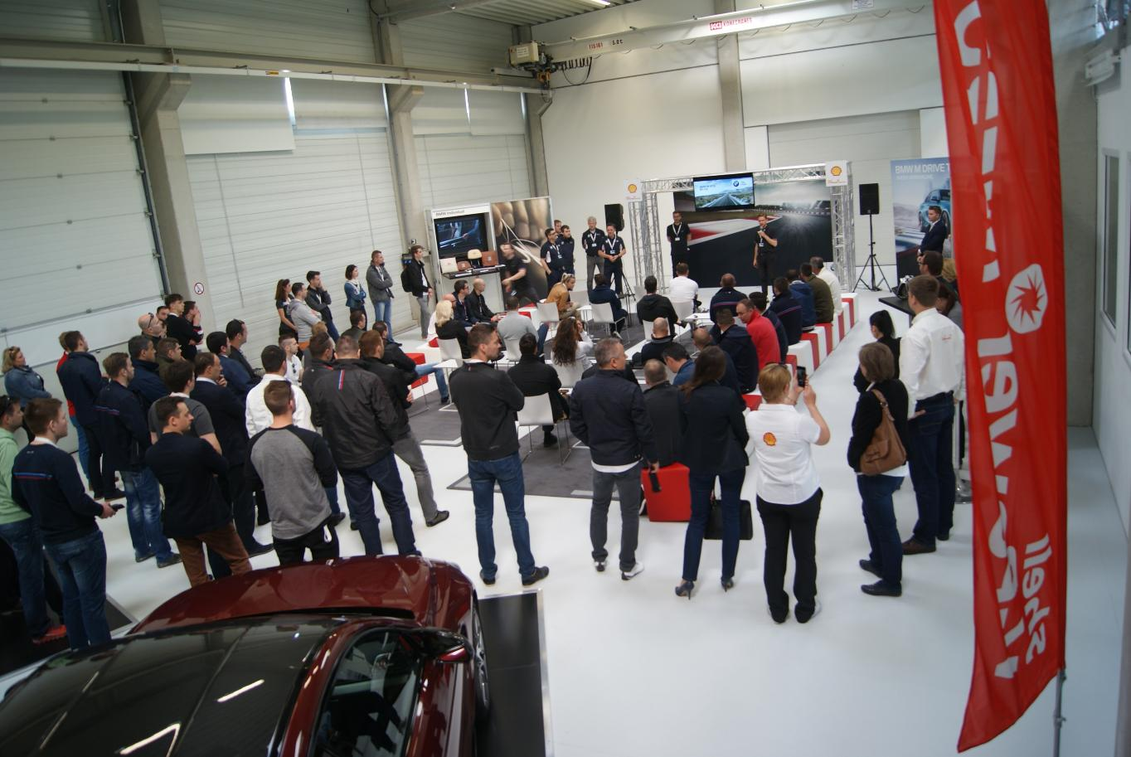
BMW M
Performance Tour
Authorised dealer event
For whole DACH-region
Testdrive of different models
Fast laps on (wet-)circuit
Presentation of latest features

Slide 13
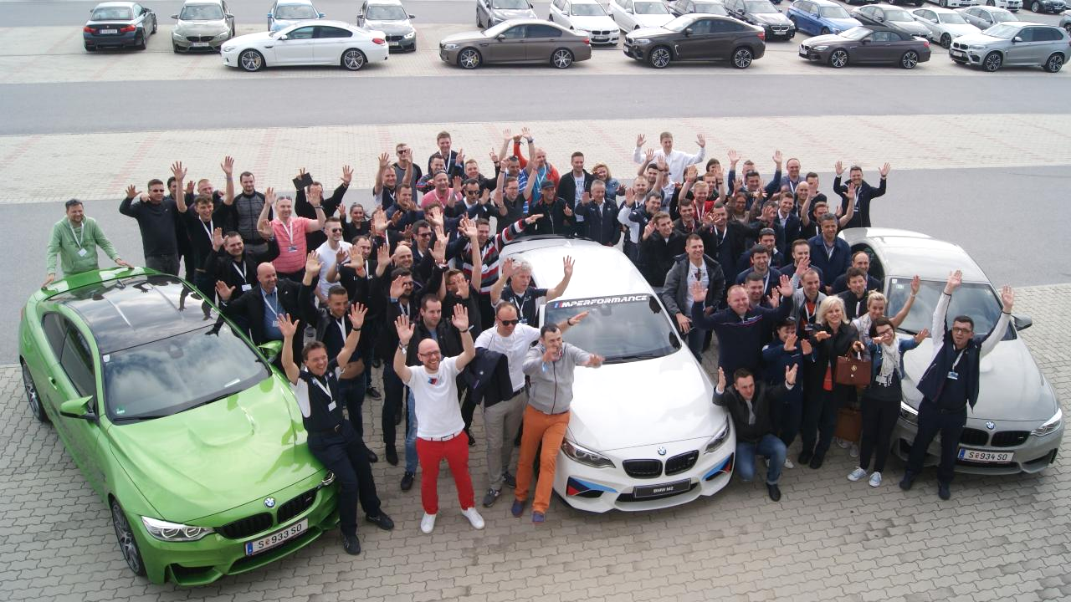
BMW M
Performance Tour
Authorised dealer event
For whole DACH-region
Testdrive of different models
Fast laps on (wet-)circuit
Presentation of latest features

Slide 14
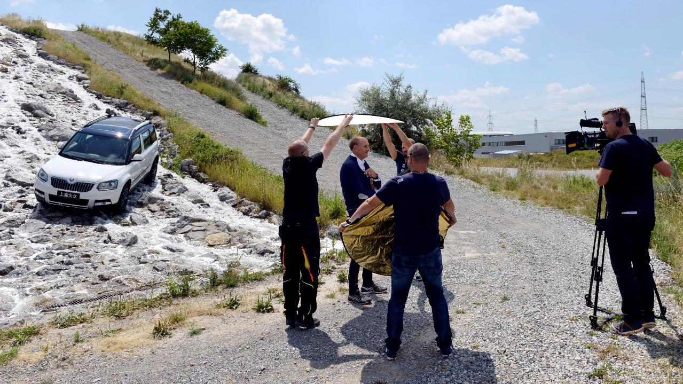
Skoda 4x4
Press Driving Experience
Two week media event
VIP treatment: 1 car per guest
Race drivers & board members
Worldwide coverage
China launch of Skoda Yeti

Slide 15
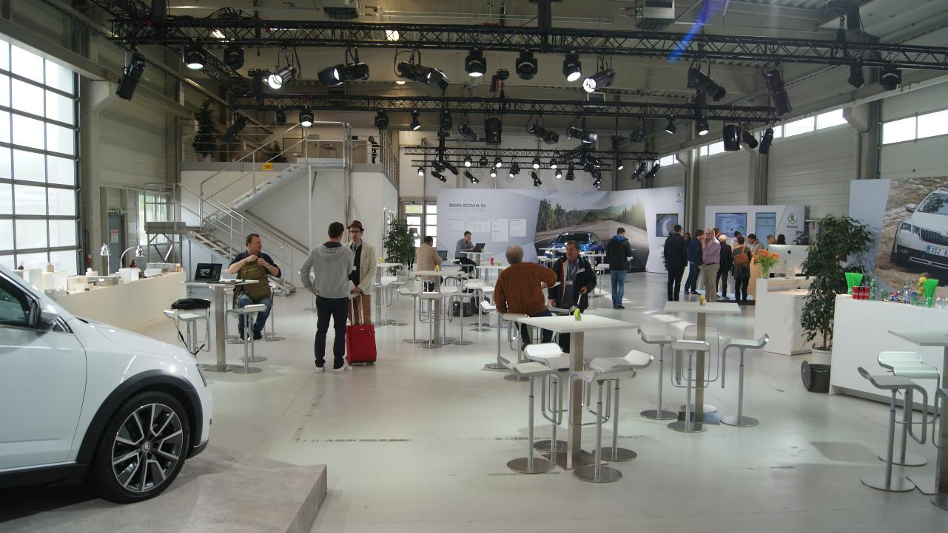
Skoda 4x4
Press Driving Experience
Two week media event
VIP treatment: 1 car per guest
Race drivers & board members
Worldwide coverage
China launch of Skoda Yeti

Slide 16
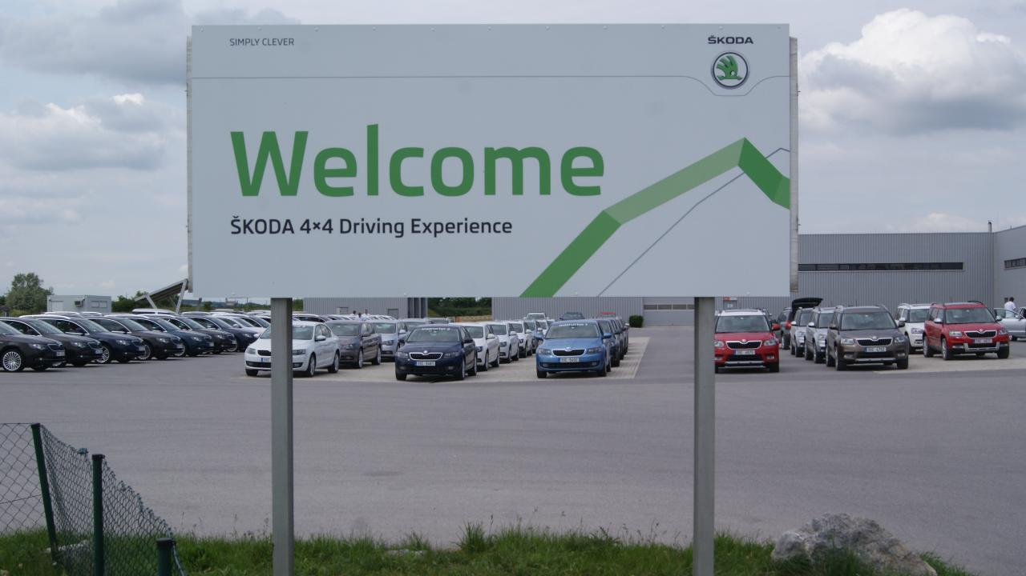
Skoda 4x4
Press Driving Experience
Two week media event
VIP treatment: 1 car per guest
Race drivers & board members
Worldwide coverage
China launch of Skoda Yeti

Slide 17
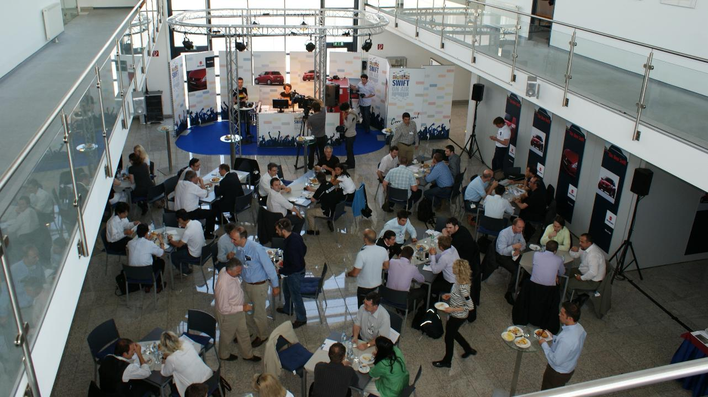
Suzuki Swift
Train The Trainer Event
International Launch Event
2 days á 65 European managers
Reveal and Workshops
Radio station in the event hall
Broadcast over the whole track

Slide 18
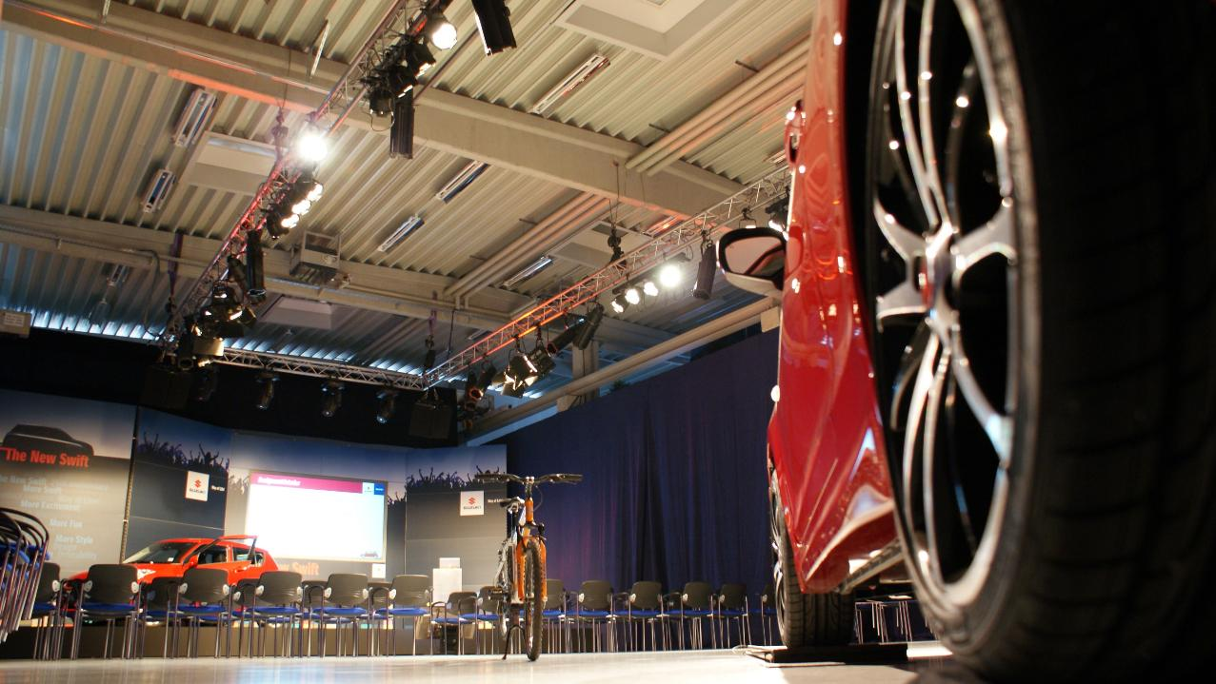
Suzuki Swift
Train The Trainer Event
International Launch Event
2 days á 65 European managers
Reveal and Workshops
Radio station in the event hall
Broadcast over the whole track

Slide 19
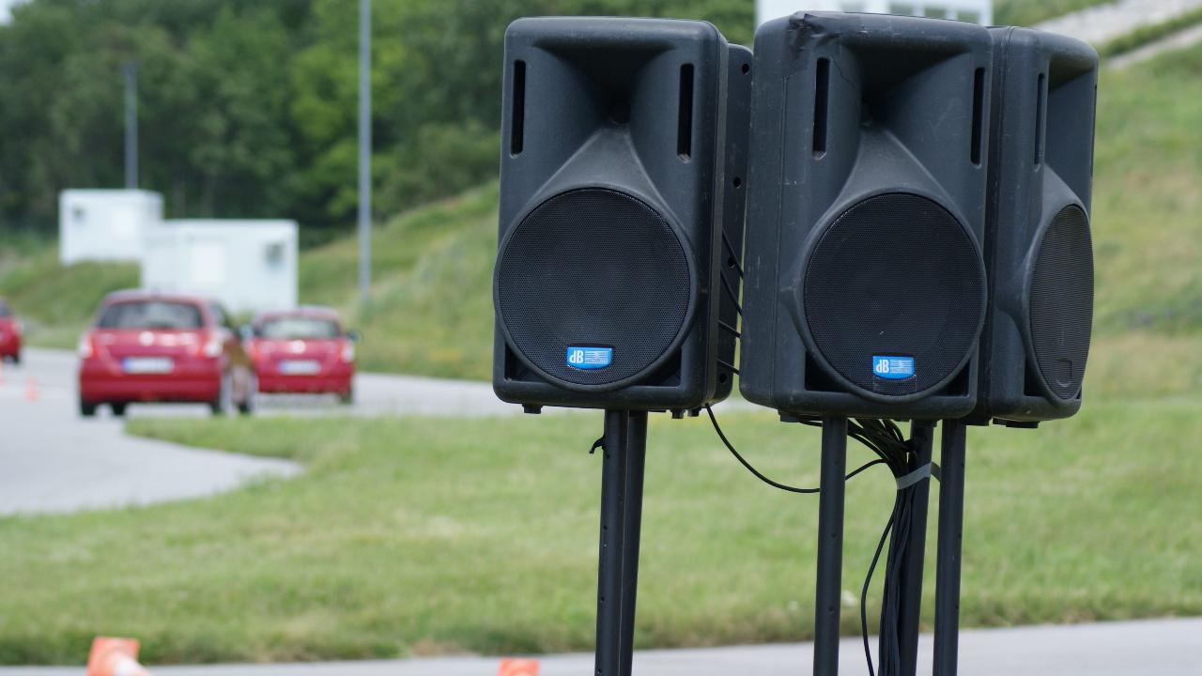
Suzuki Swift
Train The Trainer Event
International Launch Event
2 days á 65 European managers
Reveal and Workshops
Radio station in the event hall
Broadcast over the whole track

Slide 20
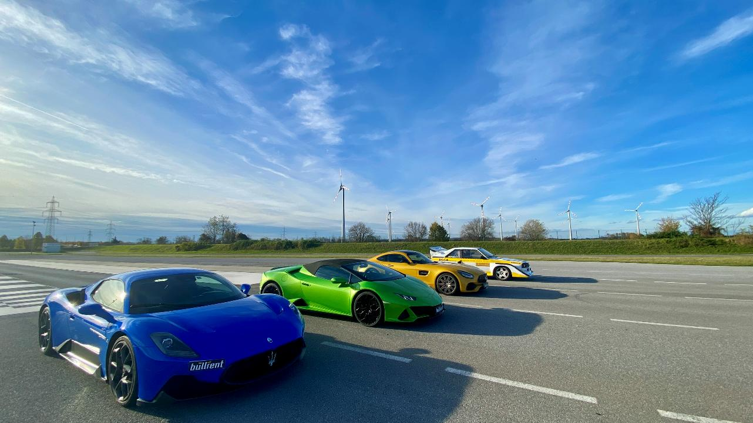
Sports Car Events &
Circuit Driving
Trainings for B2B & B2C
Track days with adrenaline
Computer controlled irrigation
Variable track characteristics
Extendable with other modules

Slide 21
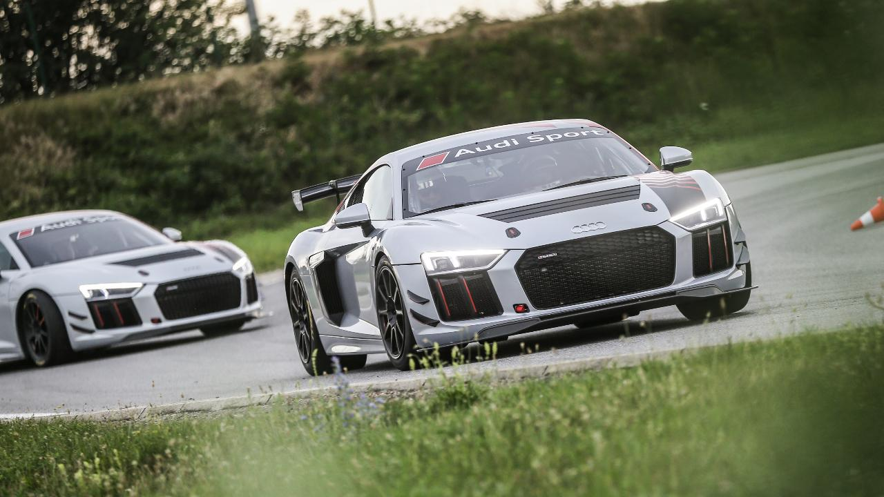
Sports Car Events &
Circuit Driving
Trainings for B2B & B2C
Track days with adrenaline
Computer controlled irrigation
Variable track characteristics
Extendable with other modules

Slide 22
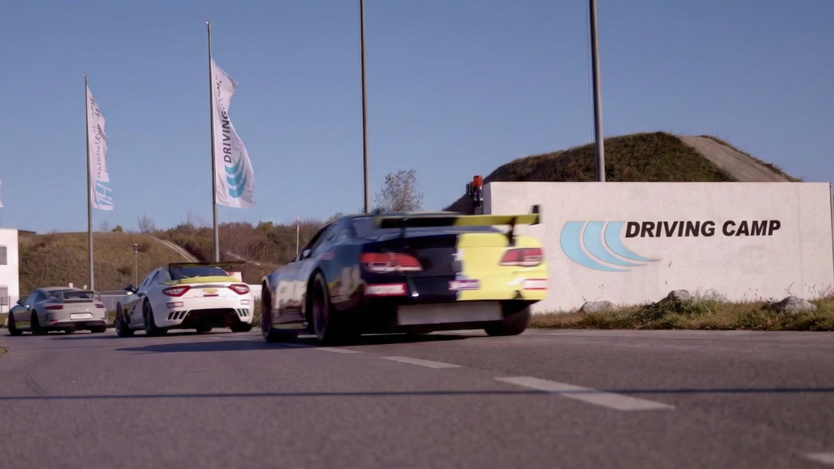
Sports Car Events &
Circuit Driving
Trainings for B2B & B2C
Track days with adrenaline
Computer controlled irrigation
Variable track characteristics
Extendable with other modules

